Slide 1
General Formatting and Format Ideas For Nimbus Navigator
10/30/24

Slide 2
General Overlay
Proposal to create 4 General tabs:
Weather Generator
Weather App/ Weather info Containing:
7 Day Weather Forecast
General Daily weather Info
Climate Contest: Weather Questionare/ Trivia
Weather Games Containing:
One Drag and Drop Weather Game
One writing weather game
One Clicking weather Game

Slide 3
Login Page

Slide 4
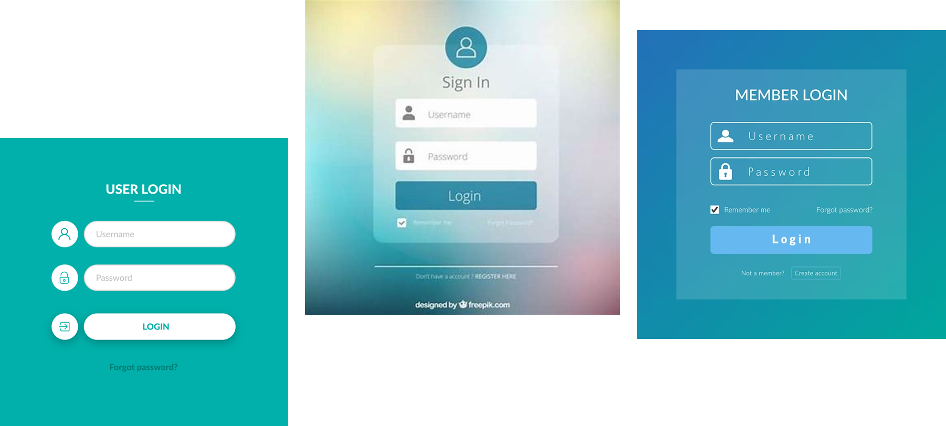
General Login Ideas:

Slide 5



USER LOGIN
Username
Password

Slide 6
Weather Info Pages

Slide 7
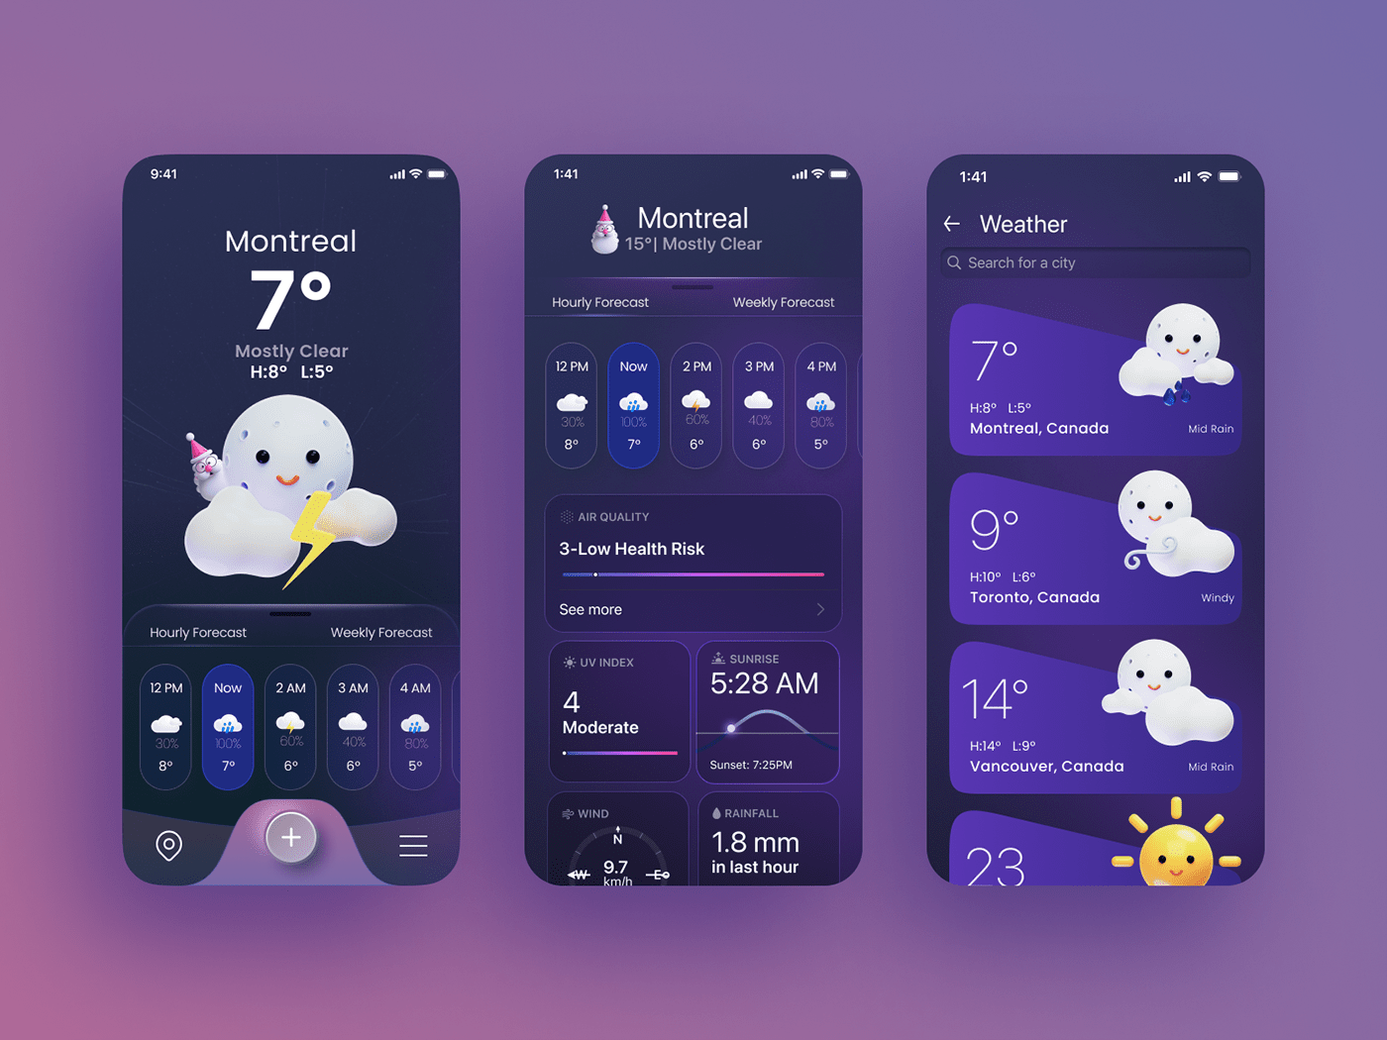
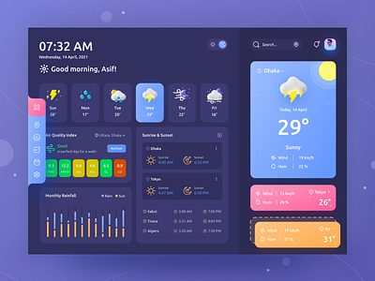
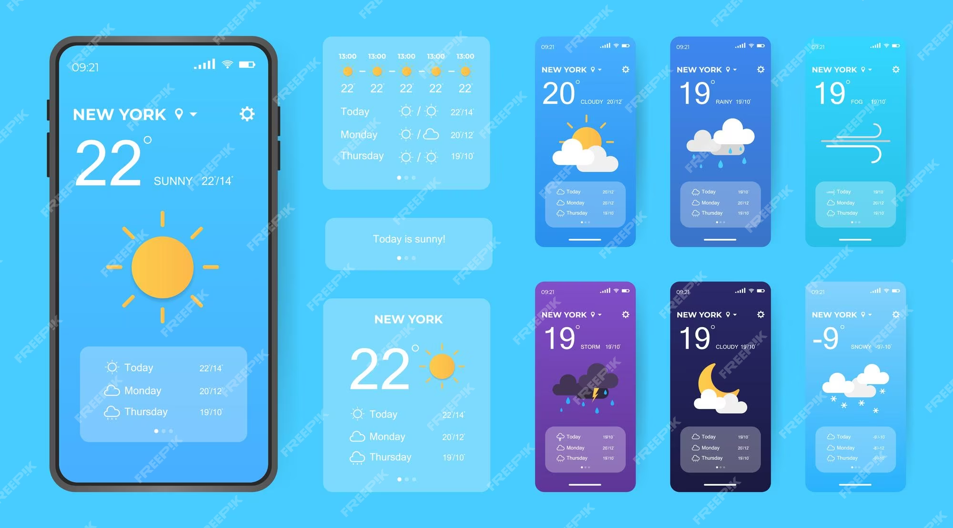
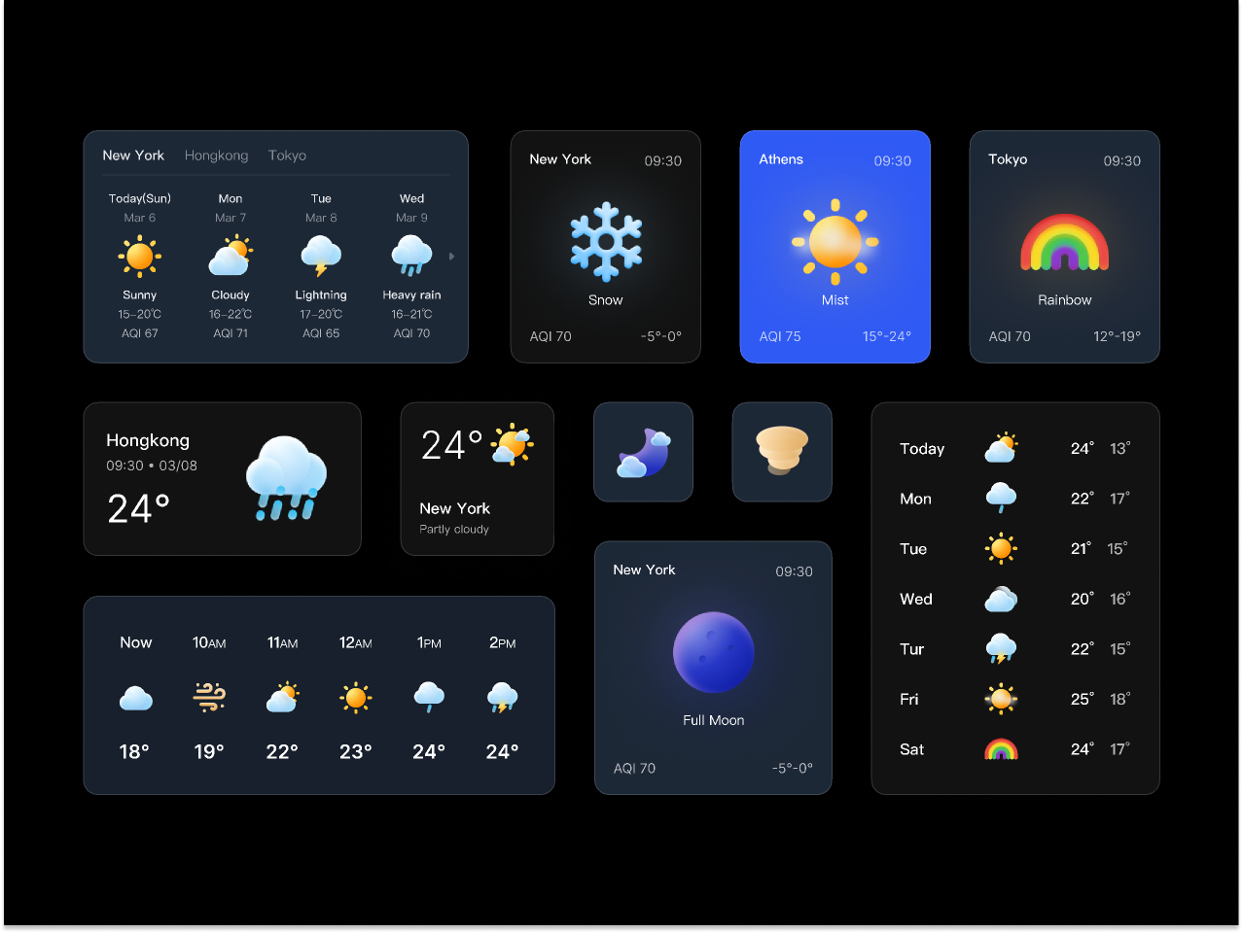
Here Are Some General Weather Page ideas

Slide 8
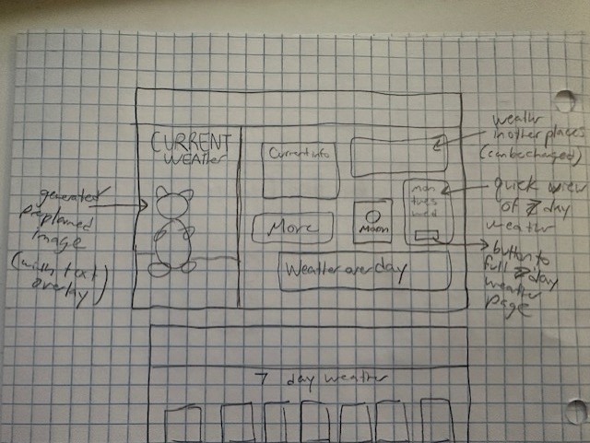
Weather Info Pages
I think that we should have our cartoon image on one side of this page.
The other side should be for weather info sorted into a bunch of different cards.
We will need general weather icons for sunny, cloudy, partly cloudy, etc. May be cool to implement our animal into these.
(Possible discussion of only choosing like 1 main animal, would make this much easier… my vote capybara)
(we could still have an animal generated in the weather generator just one main one for the app. Before kids use the weather generator our main animal will be sitting there.

Slide 9
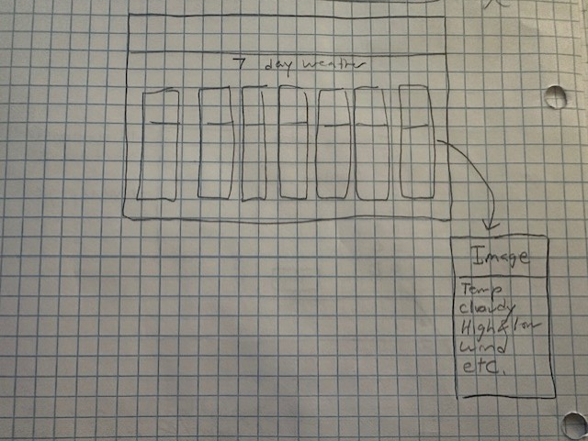
Weather Info Pages: Seven day forecast
My goal for the seven day weather is to make seven cards that span the screen. In each one is a picture with the weather and our animal. Below we do different weather statistics. We have time to figure out what those are. We can look at some examples.
This should be available in drop down and there should be a button on the main weather page that can take you to the 7 day forecast.

Slide 10
Weather Games

Slide 11
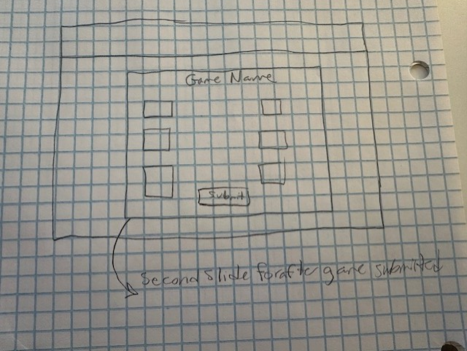
Games General Outline
This should be pretty simple. My goal is to just put a couple of worksheets into an online game/quiz form. We should incorporate our mascot animal. and have a game slide and a check answers/submit page.

Slide 12
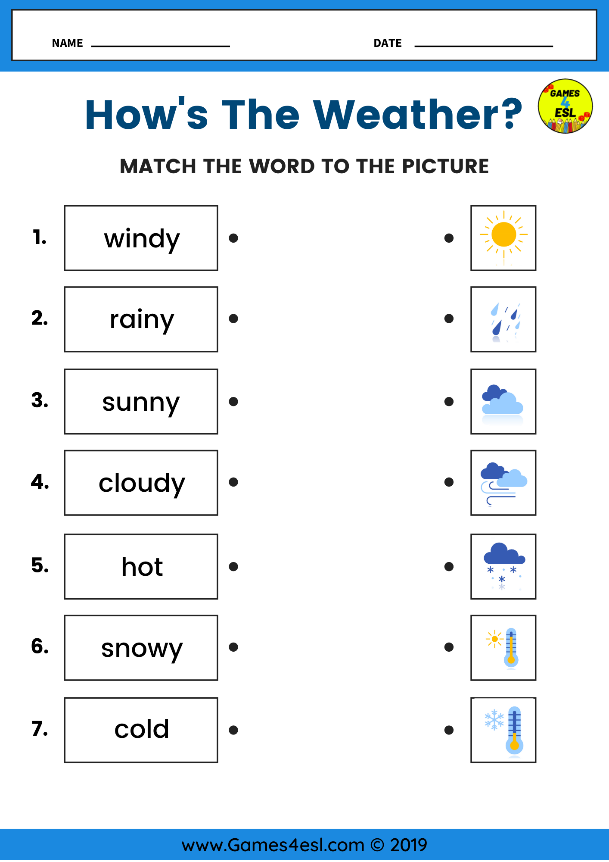
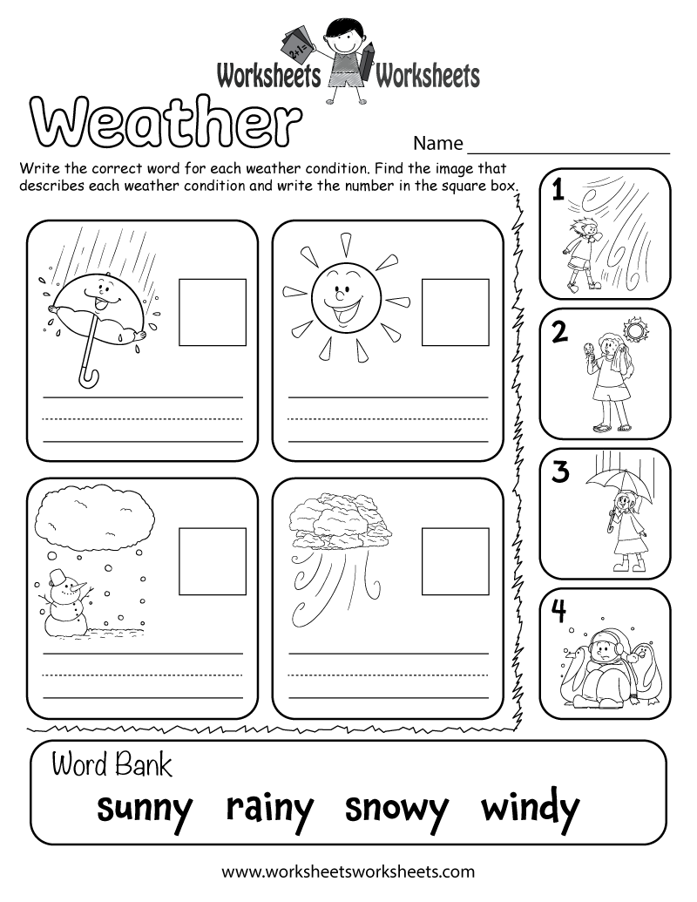
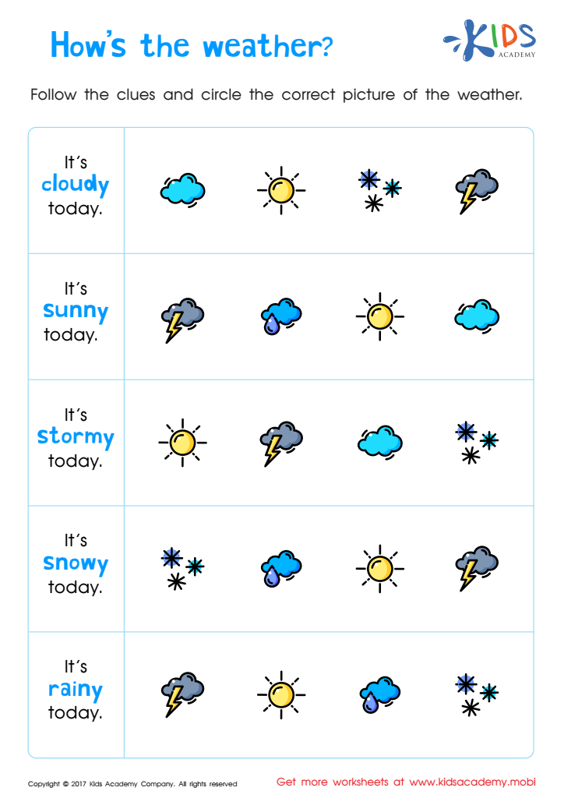
Here are some General kids worksheets I think would be really easy to implement on our website:

Slide 13
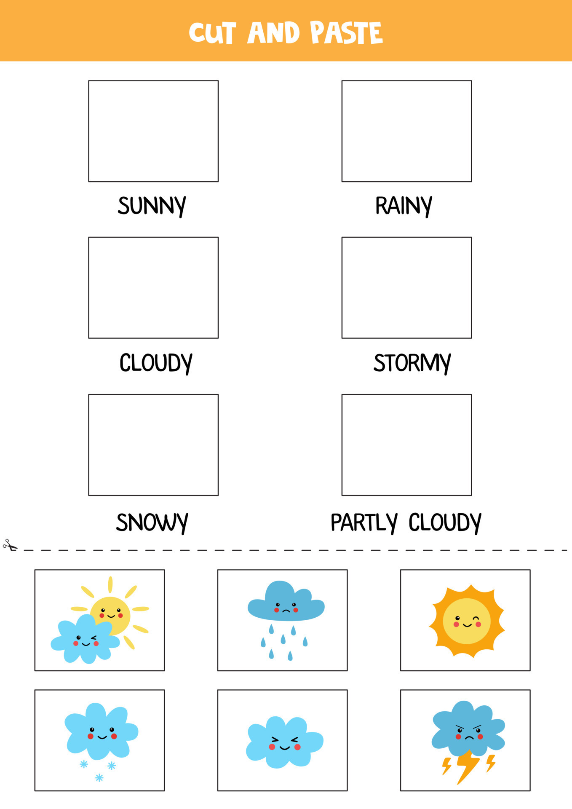
Here is another kids worksheet I think would be really easy to implement on our website:
This one would need the drag and drop feature
Drag and drop matching items

Slide 14
Climate Contest

Slide 15
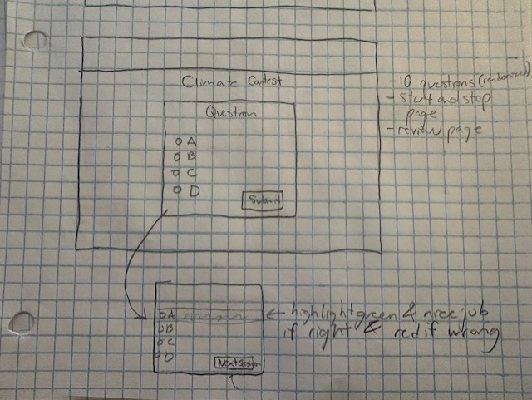
Climate Contest idea:
For this I suggest we make a database of around 30 questions. They are randomized in the quiz each time you take it. We can choose whether or not to save results. For each question there will be a submit buttion and then at the end you should be able to scroll through all of the questions to see if you got them right or not.

Slide 16
Weather Generator

Slide 17
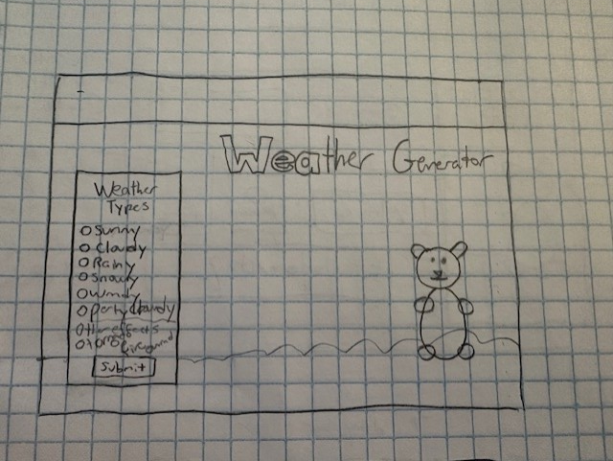
Weather Generator
This should be an AI based screen where you can choose the image generated, the type of weather, the time of day and other weather related affects.

Slide 18
Logout

Slide 19
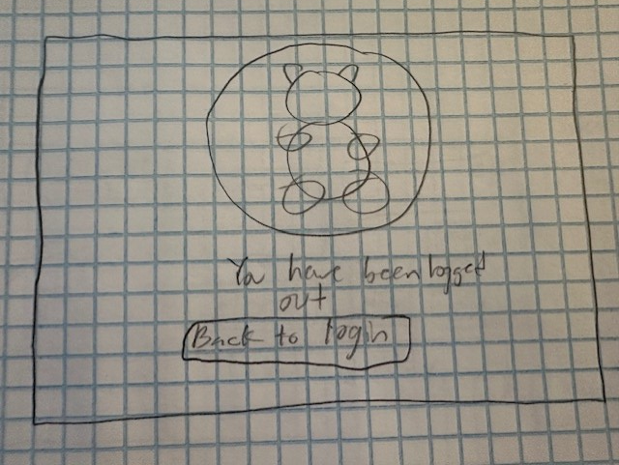
Logout
We Want to make logout simple. Just an image of our character, a phrase saying you have been logged out, and a button back to our main login page.

Slide 20
Other Things to think about
We need to think about color schemes, how we can split this up, what specific data we want on each slide, etc.

Slide 21
One Page For Weather Generator, For AI images:
Box for submit, Add different weather types,

